Slide 1
3471 Project - Iteration 3
Runtime Terror:
Ashley Bickham, Joshua Hunter, Austin Lehman, Tyler Ross

Slide 2
Background Story
In the beginning of this project, we wanted to create a product site similar to that of Amazon or Etsy, with the outcome being that of an online inventory store. Rather than focus on one section of shopping, like clothes, food, or electronics, we wanted to create a store that allows for the user to search any type of item on our interface. We were faced with questions when trying to create this project, such as “What should the final result look like?” and “How do we go from a simple, drawn design to a more complex, fully functioning program?”
One of our biggest challenges we were hit with was the ignorance when it came to the amount of work we would have as we worked to complete each iteration. Each part in itself seems very simple and manageable, but with the growing code-line total, the complexity can quickly ramp up.
Toward the end of this project, we learned to work off of the work of each other more efficiently than when we began working together. We were successfully able to create a (very bare boned) store site in order to hold, sell, and restock the items held in our store.

Slide 3
User Roles
Ashley-
Presentation / PDF Management
Generate Report, View Product Availability, Return Item UC’s
Joshua-
Project Lead / GIT Management / Presentation
Make Purchase, Restock Item, Delete Product UC’s
Austin-
Website Maintenance
Add Item to Cart, Make Account, Remove Item from Cart UC’s
Tyler-
JUnit Test
Add Item to Wishlist, Send/Ship Item, Add New Product UC’s
All-
General Documentation
3 Use Cases Each
Implementation inside Novama project
Videos explaining each use case in depth

Slide 4
Project Implementation
The GUI is separated into 4 main view classes. The first is HomeView, which is where the user can login or create a new login. The second view class NozamaView is the main page of the store that shows its available items. NozamaController is a Controller that controls the table that appears in NozamaView, as well as handles many of its operations. The third view class is ShoppingCartView, which shows the contents of the customer’s shopping cart as well as it’s subtotal and a checkout button. Like NozamaModel, ShoppingCartController is a Controller that handles the data and operations for ShoppingCartView. The last view class is WishlistView which displays the user’s wishlist and allows the user to edit it. WishlistController is a controller for wishlist view that functions similarly to ShoppingCartView.

Slide 5
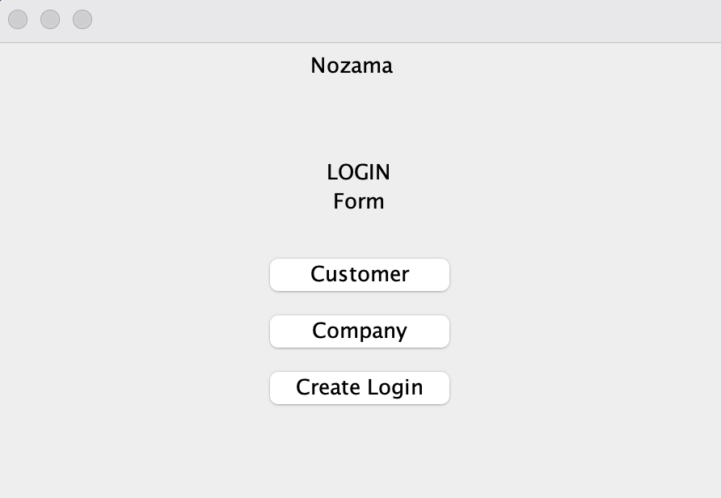
Home Page

Slide 6
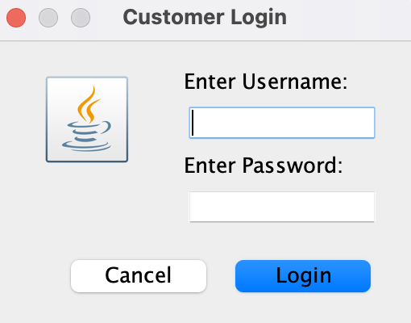
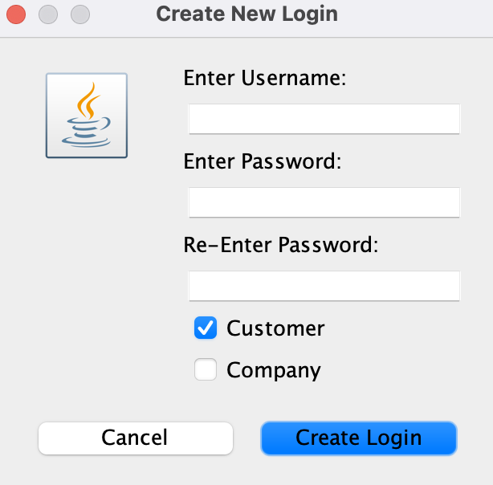
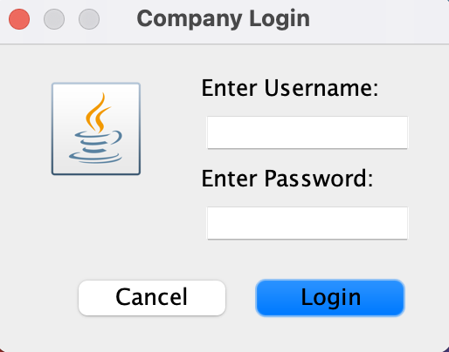
Login/Create New Login

Slide 7
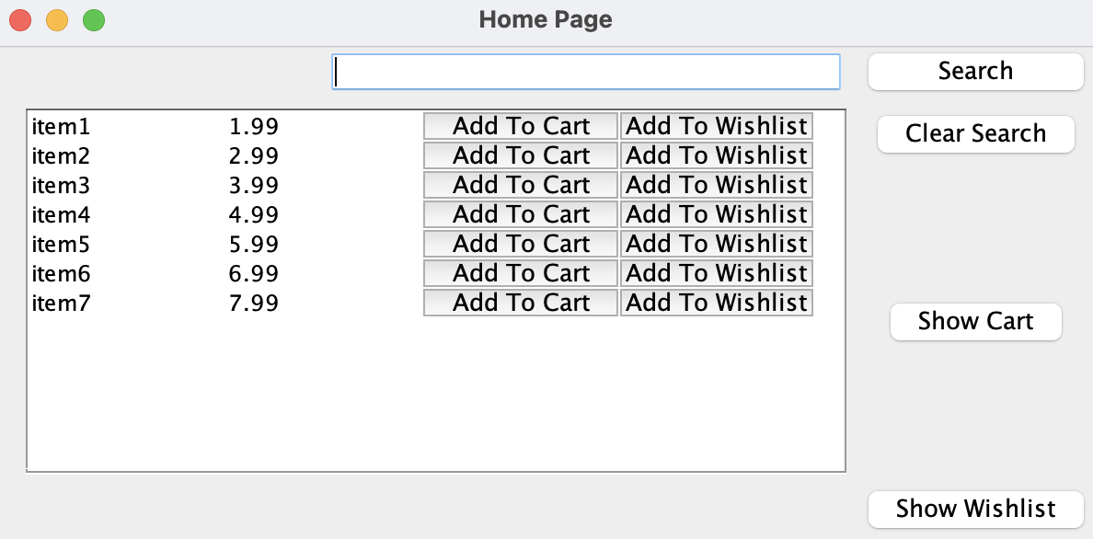
Store Home Page (Customer)

Slide 8
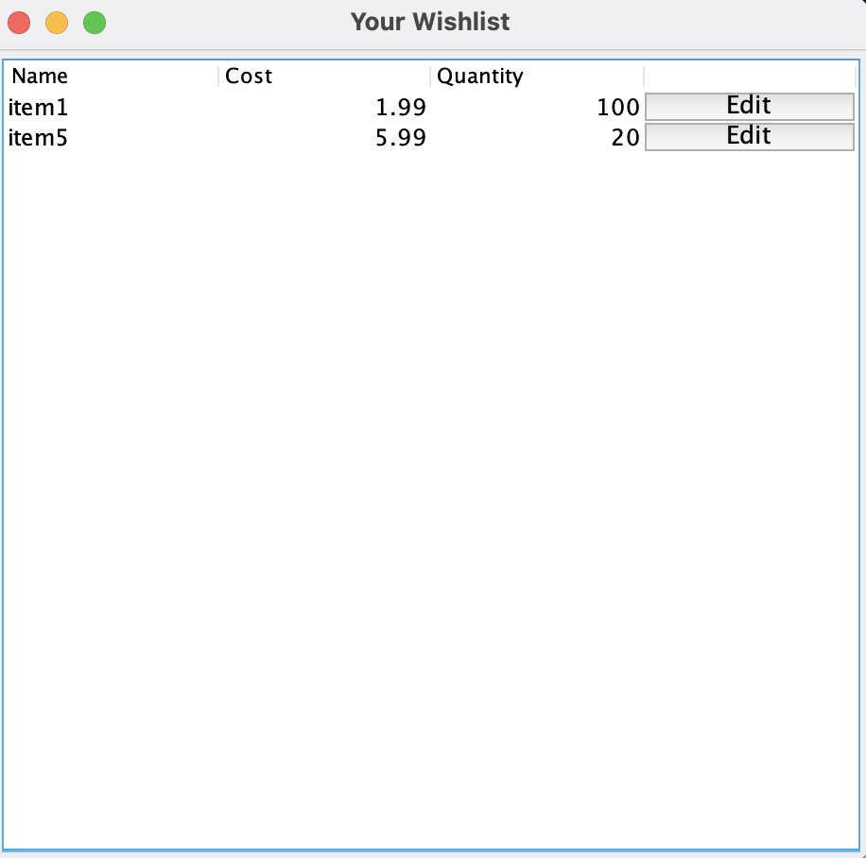
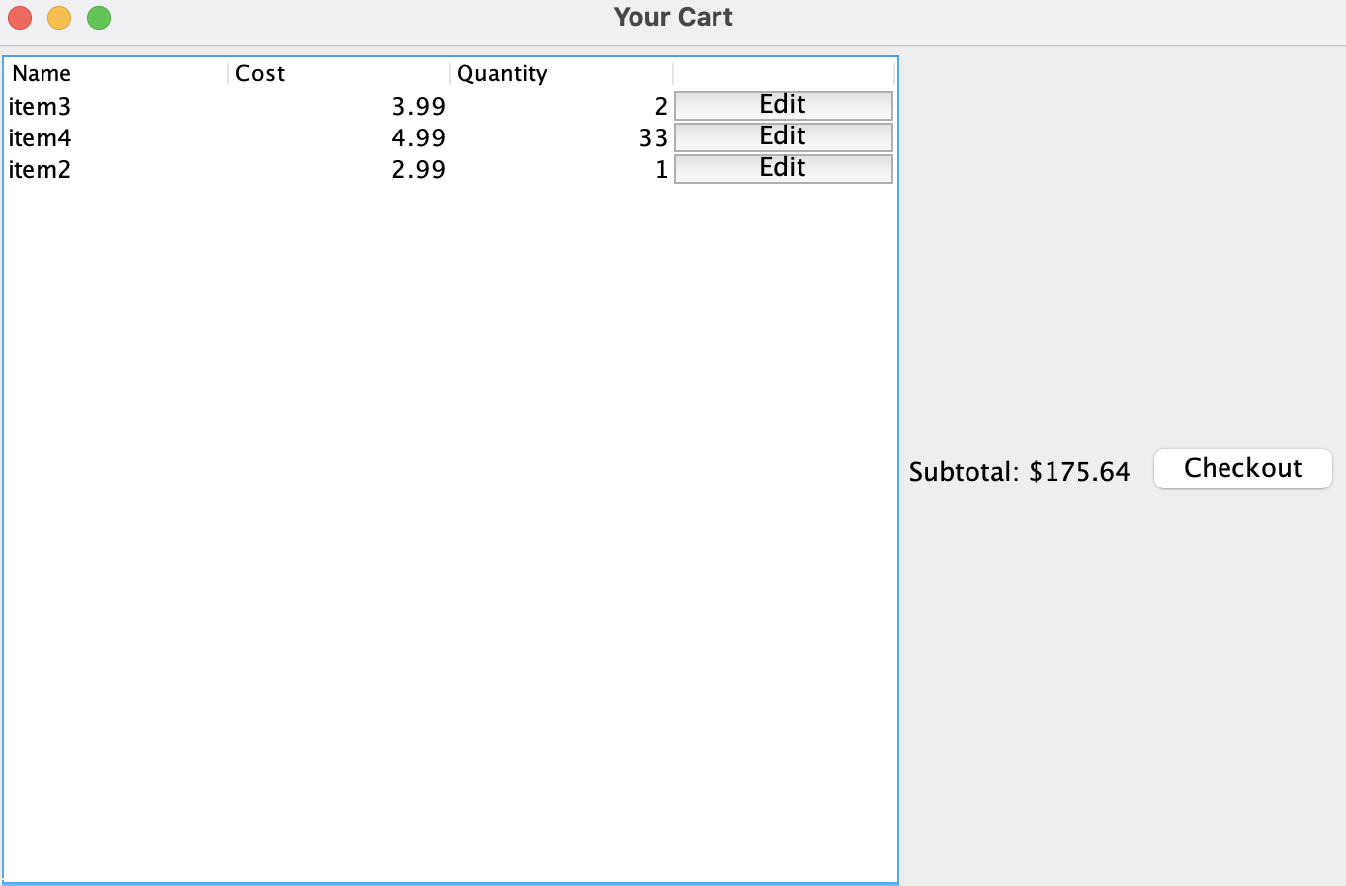
Shopping Cart/Wishlist

Slide 9
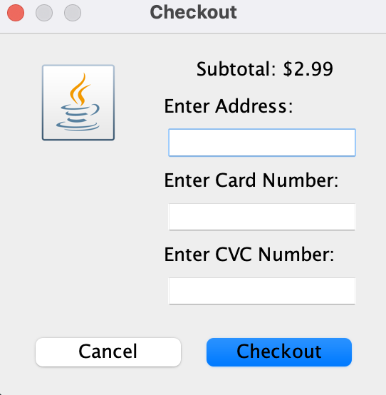
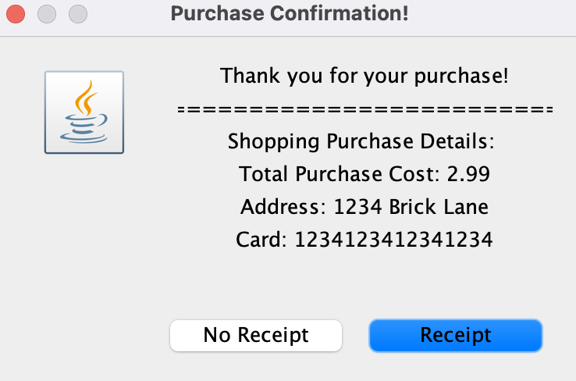
Checkout/Purchase Confirmation

Slide 10
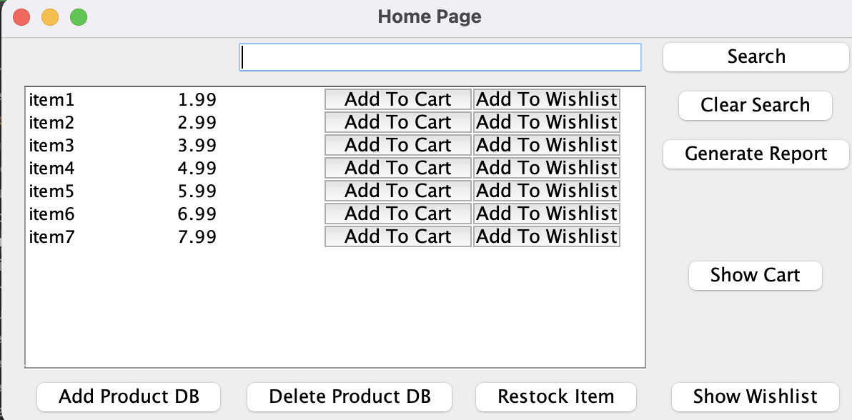
Store Home Page (Company)

Slide 11
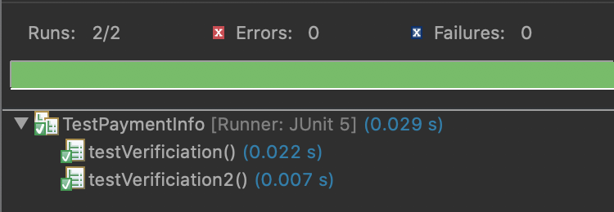
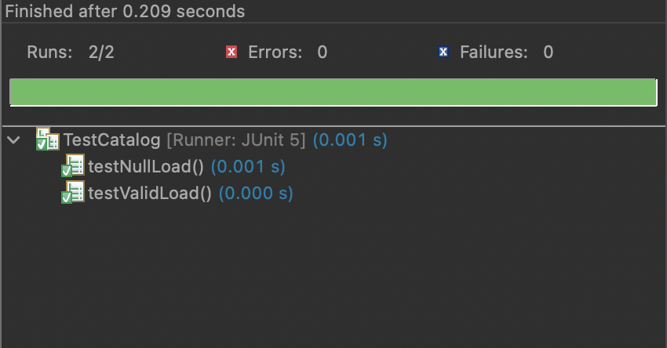
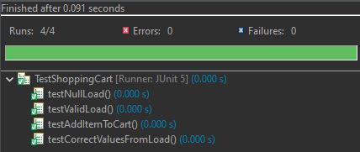
Testing
Still working on fully implementing all tests

Slide 12
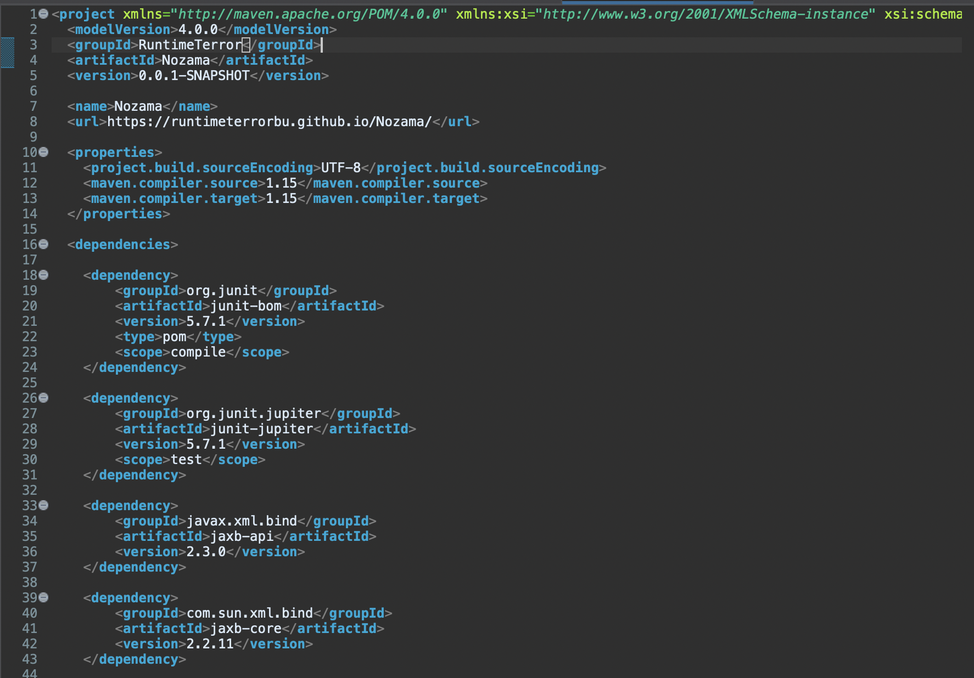
Maven

Slide 13
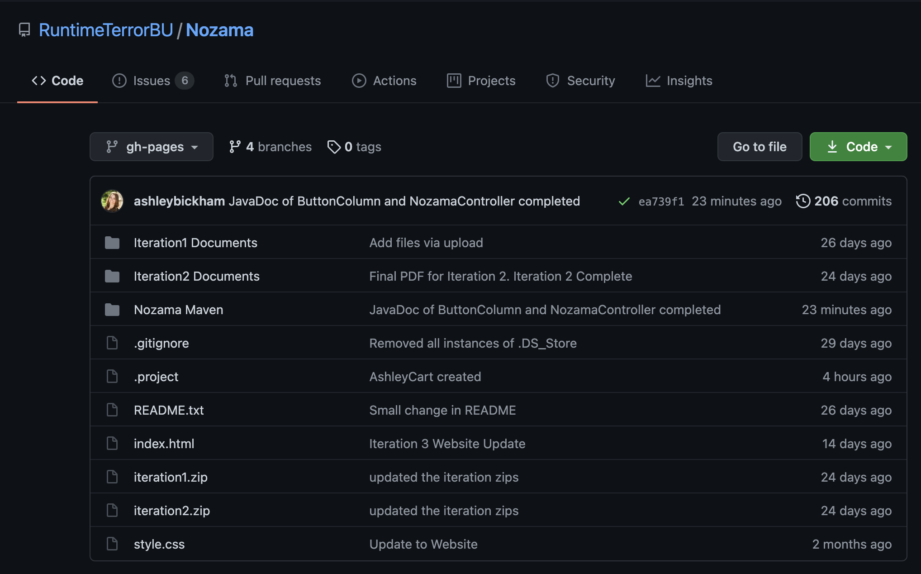
GitHub

Slide 14
Hours Worked by Each Member & Number of Commits
Ashley- 42 hours, 39 commits
Joshua- 47 hours, 44 commits
Austin- 52 hours, 96 commits
Tyler- 35 hours, 27 commits
206 Total Commits

